Slide 1
In-class Exercise 09 - Connected Component Labeling
Dhiren Gupta
-800902466

Slide 2
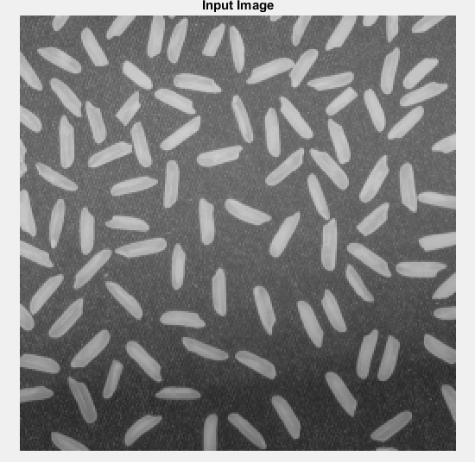
Input Image

Slide 3
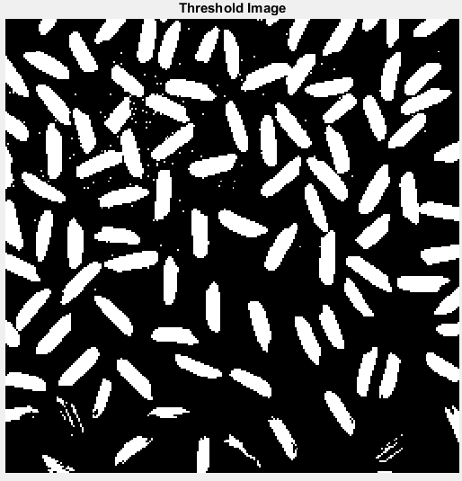
Threshold Image

Slide 4
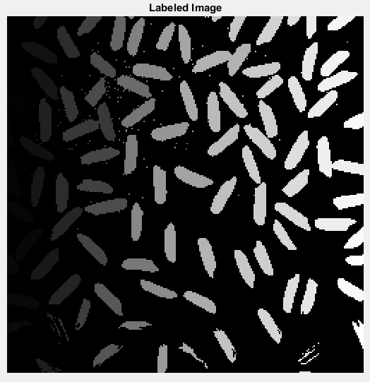
Labeled Image

Slide 5
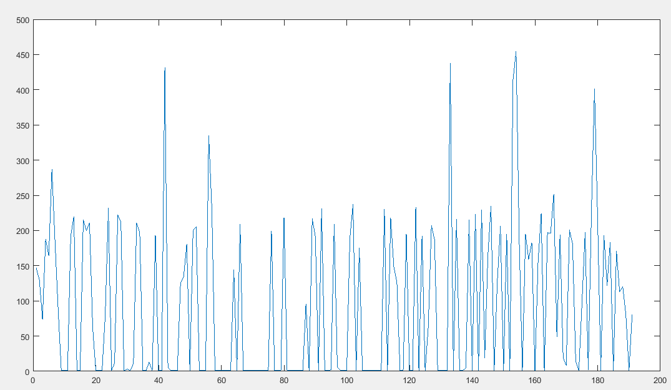
Plot For region Props

Slide 6
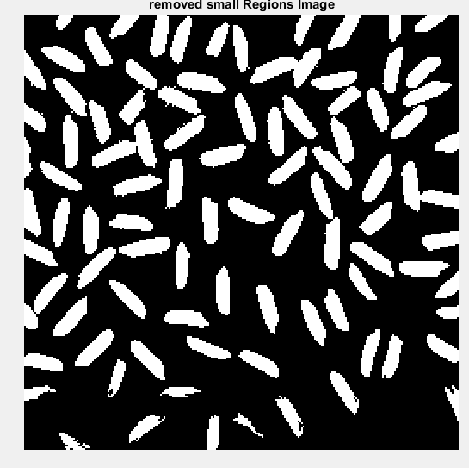
Output After removing small region
Threshold
Output

Slide 7
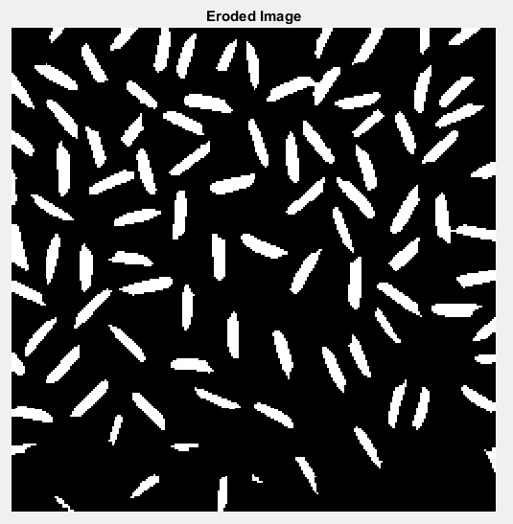
Eroded Image

Slide 8
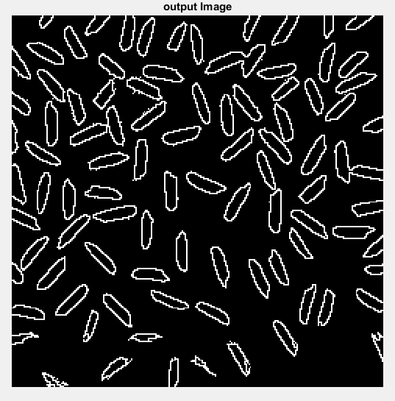
Boundary Image

Slide 9
Thank You

